Slide 1
Final Proposal
Atharv Gopaluni

Slide 2
Concept
I want to update my midterm, which was a website to showcase my media “company.”
I have more projects I want to show, but moreover, I want to add more to it. Under the about me, there will be more about me, and a more comprehensive portfolio of my work outside of the “company.”
My own personal website was currently made on a builder, and I want to rebuild it on full HTML/CSS/JS, while also adding new ideas. Additionally, perhaps I will add a light mode as well.

Slide 3
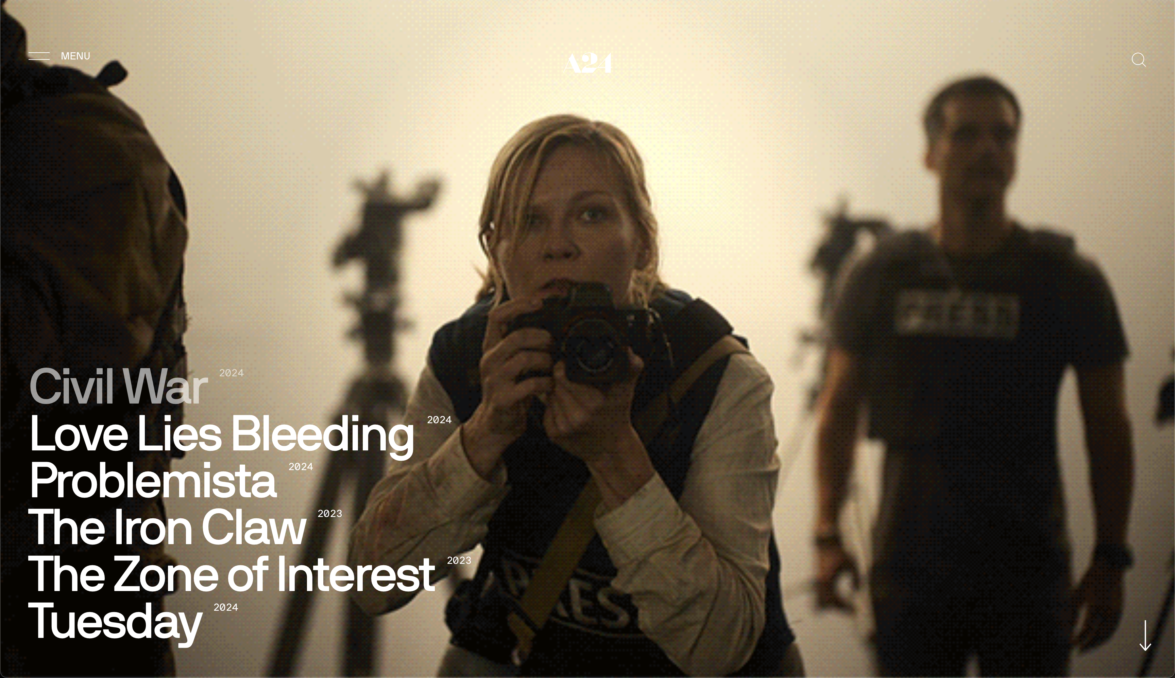

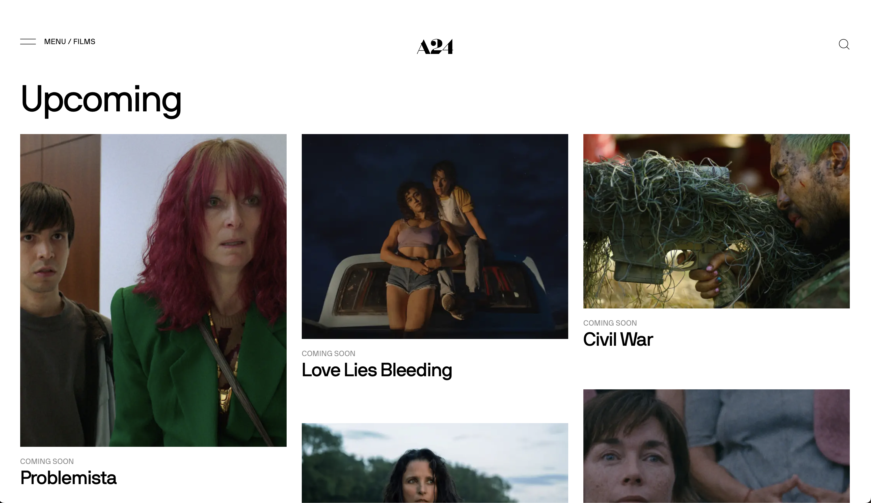
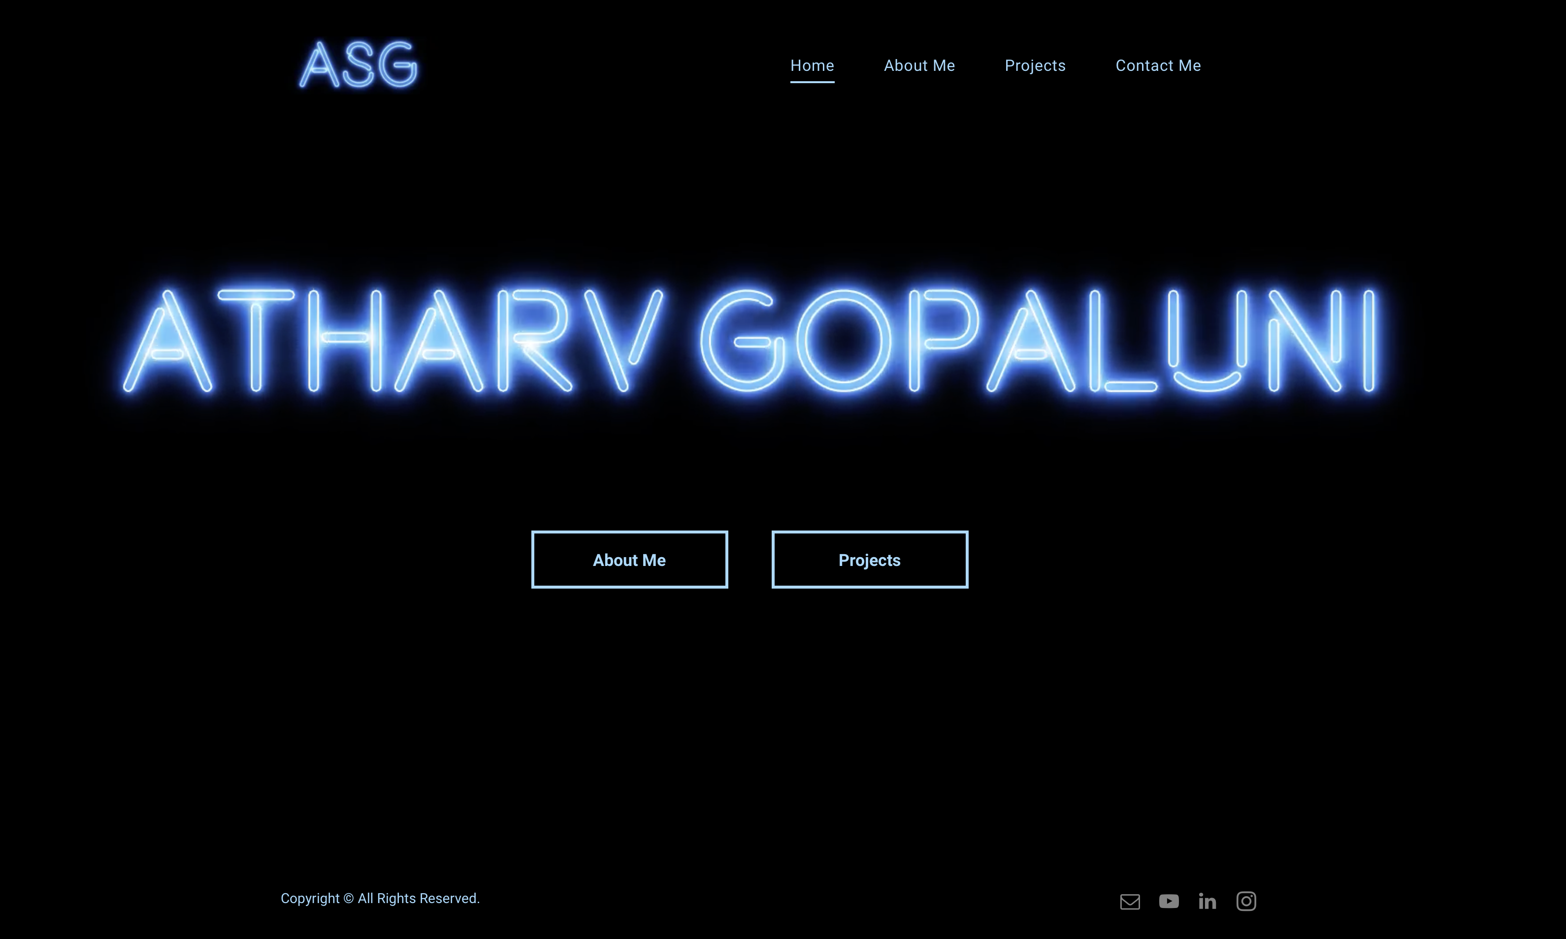
Inspiration
https://a24films.com
https://www.atharvgopaluni.com
I want to further the connection between my website and A24’s with more dramatic graphics and more pages and subpages.
A24 home page
A24 menu nav bar
A24 films page
My current personal website

Slide 4
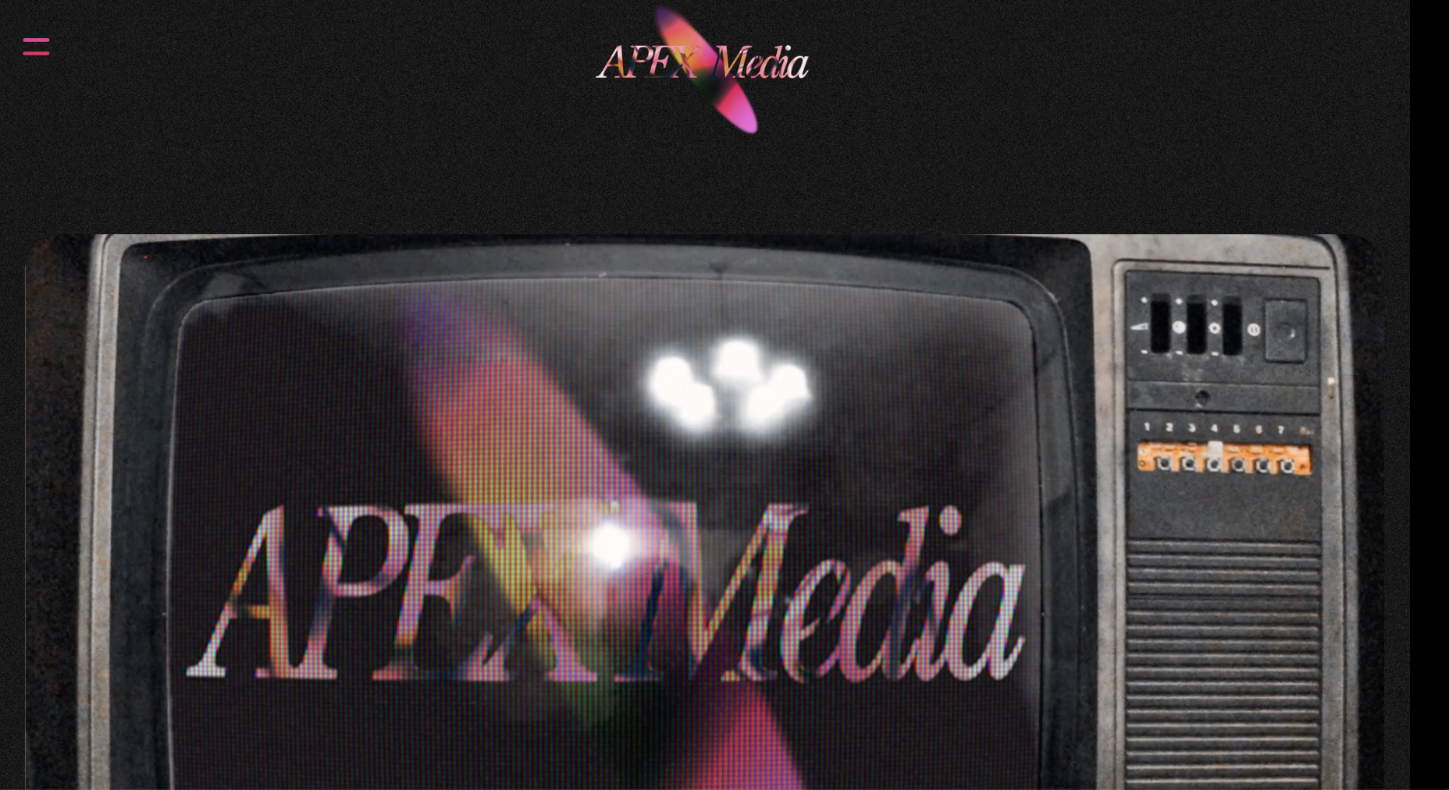
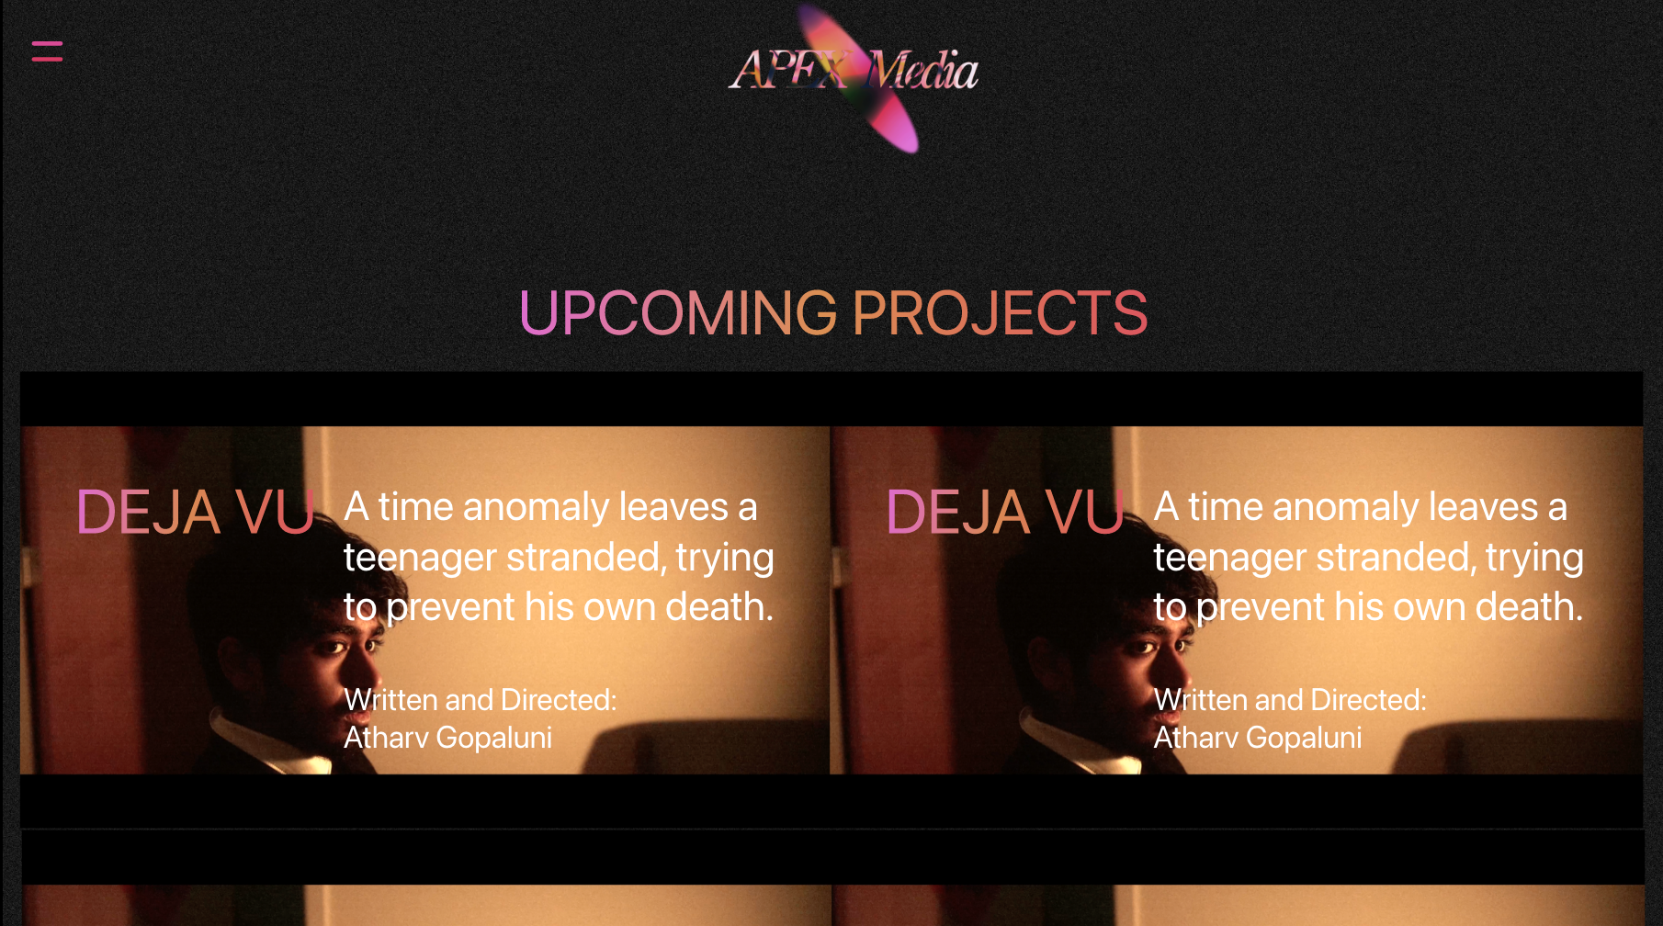
Schematics/Wireframing

Slide 5
NEW HTML/CSS/JS that I will utilize
Dropdowns
Text input (for search)
Background styling (I want a more “film” feel)
On-click fade information (more dramatic)
Animations
Overlaying pictures on top of one another
Overlaying text on images
More to come as I think of them

